Slide 1
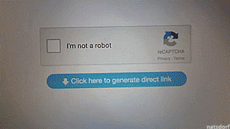
Automatic Test Generation for Physical Systems
Melony Bennis (mmb4vu)
Carl Hildebrandt (ch6wd)
Notes:
Robots are fun <3

Slide 2

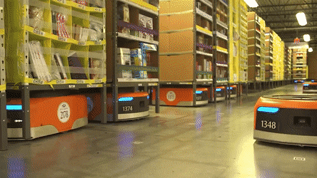
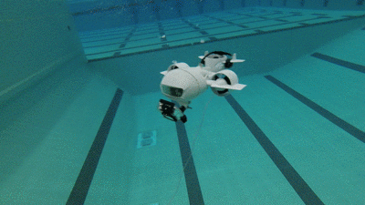
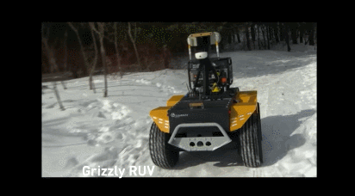
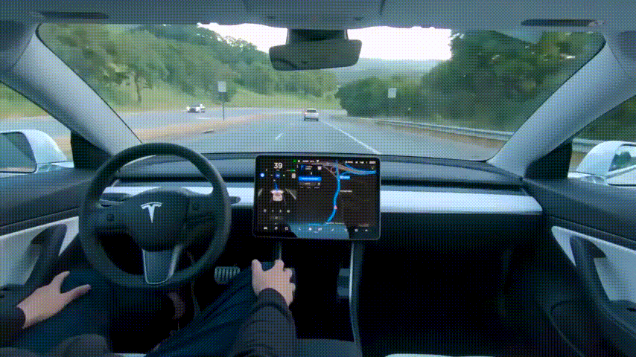
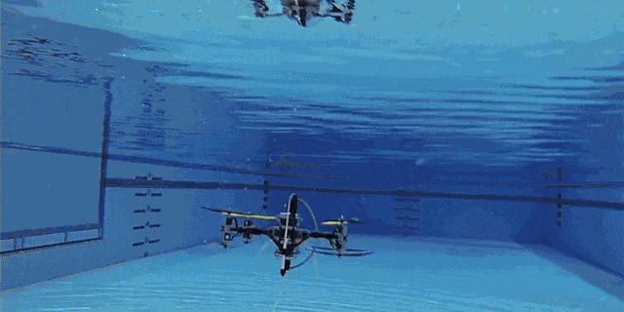
Motivation
Autonomous vehicles are becoming a reality in society
Amazon Drone-Releasing Blimp
Amazon Warehouse Robots
Autonomous Aquatic Vehicles
Autonomous Differential Drive Robots
Self Driving Cars
Arial-Aquatic Vehicles

Slide 3
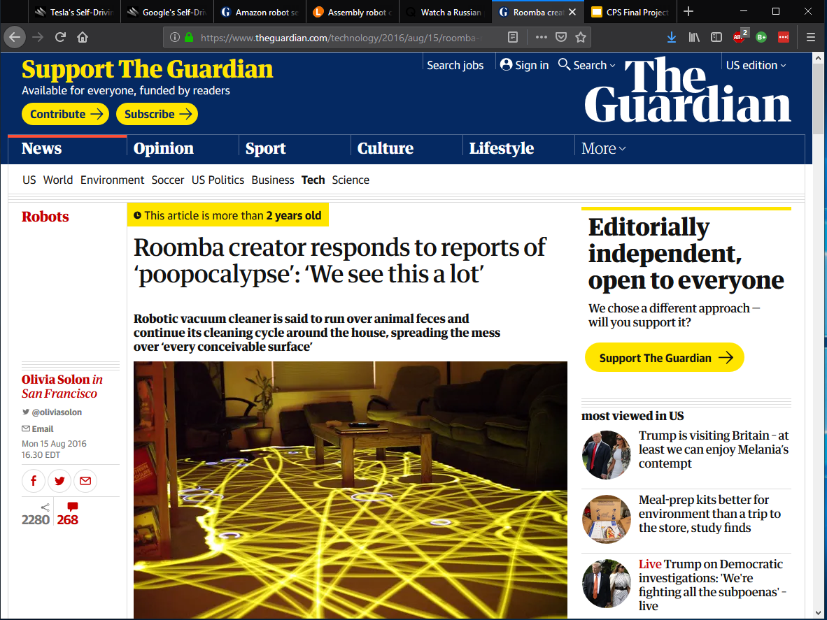
Traditional testing is not enough.

Slide 4
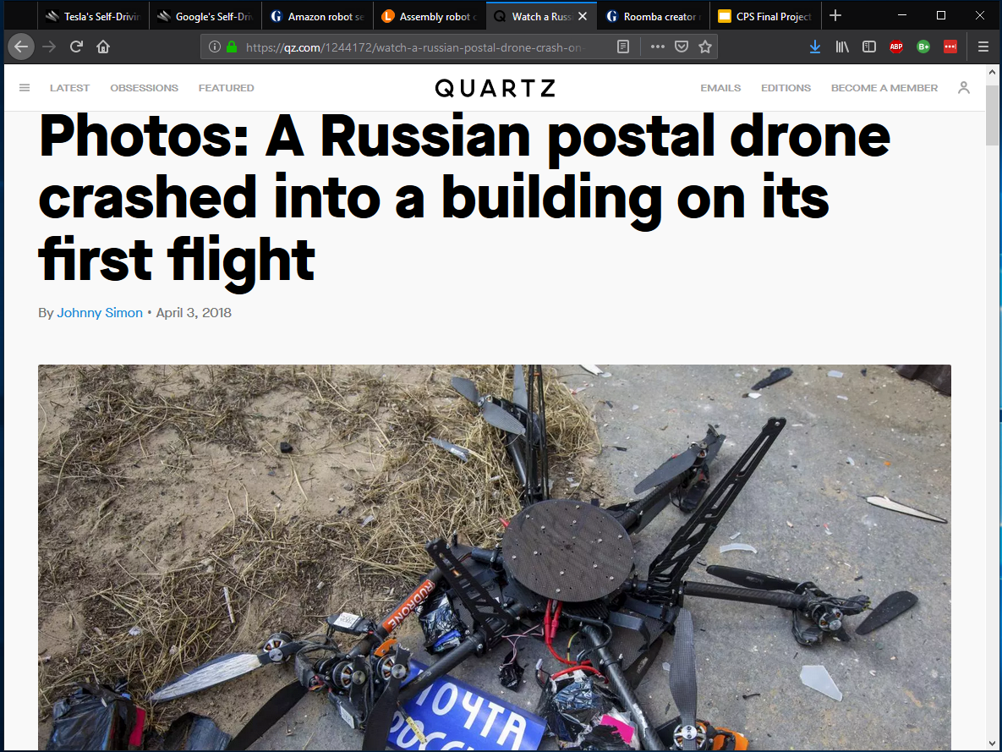
Traditional testing is not enough.

Slide 5

Traditional testing is not enough.

Slide 6
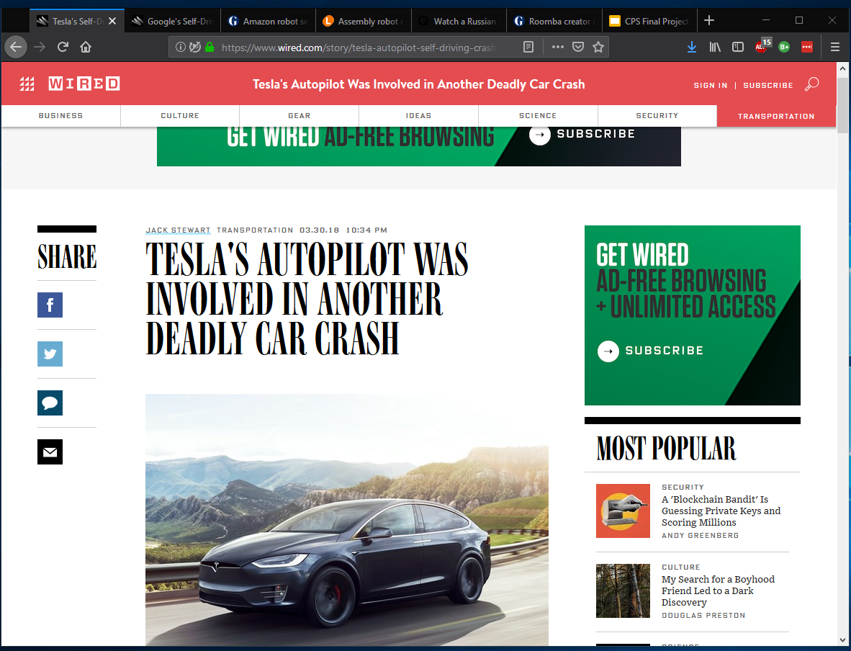
Traditional testing is not enough.

Slide 7
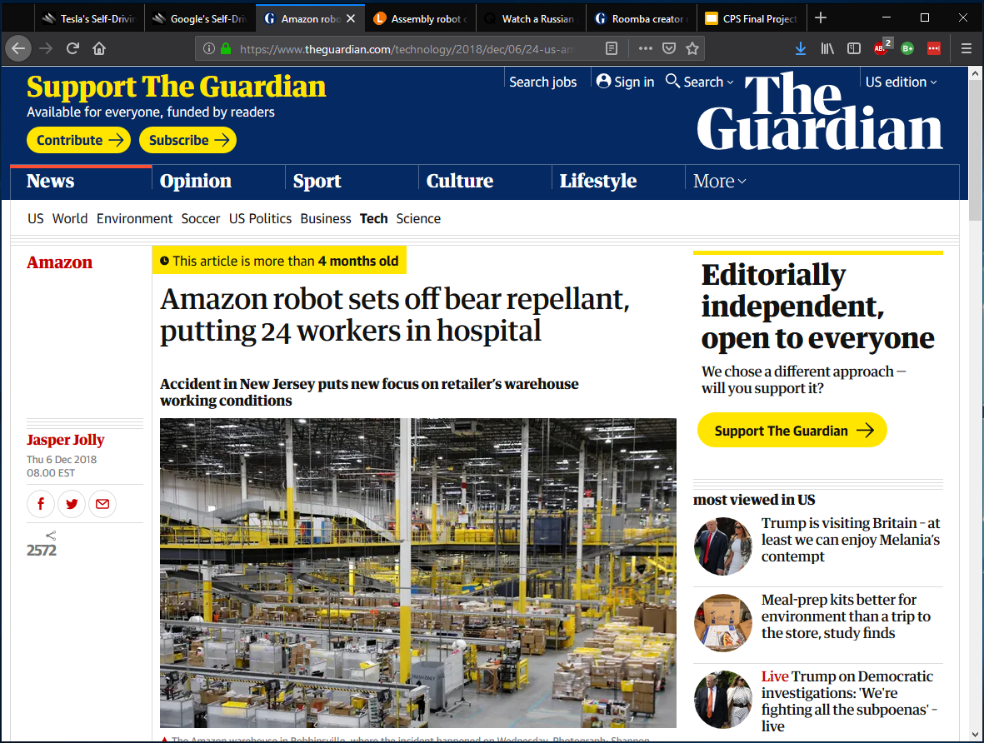
Traditional testing is not enough.

Slide 8
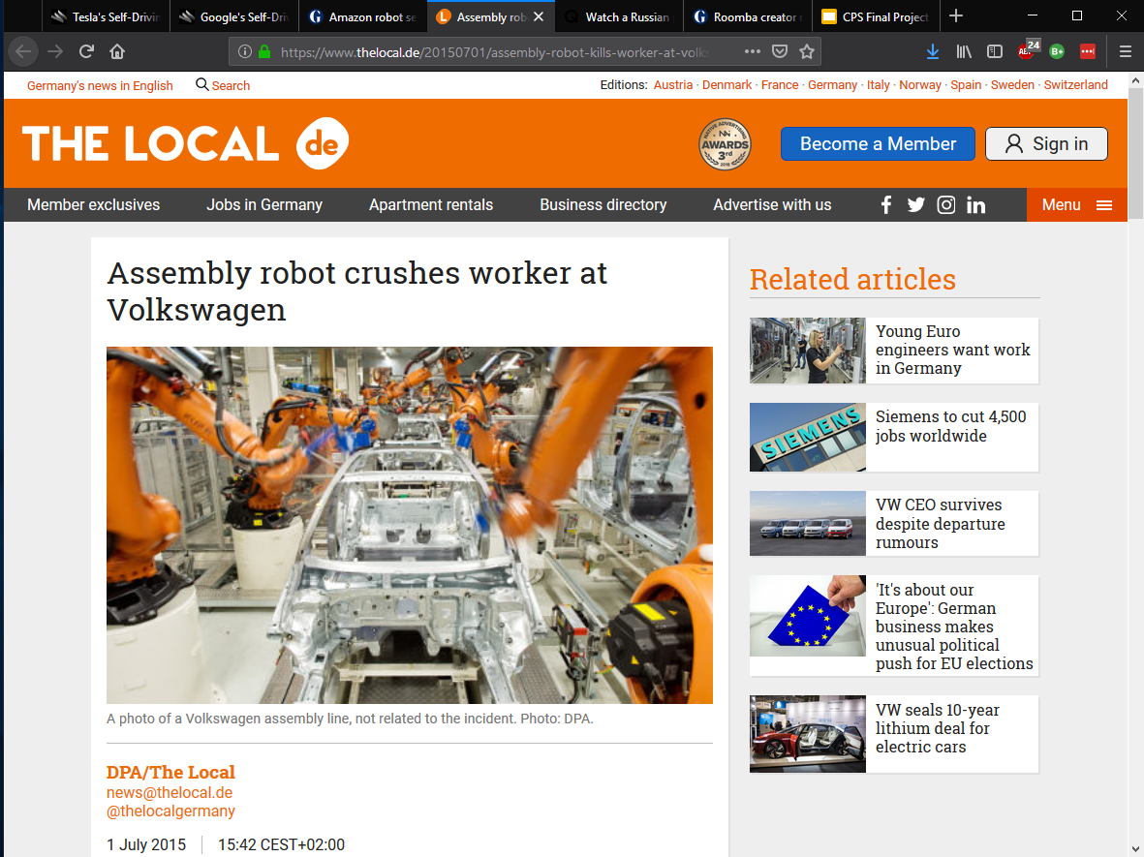
Traditional testing is not enough.

Slide 9
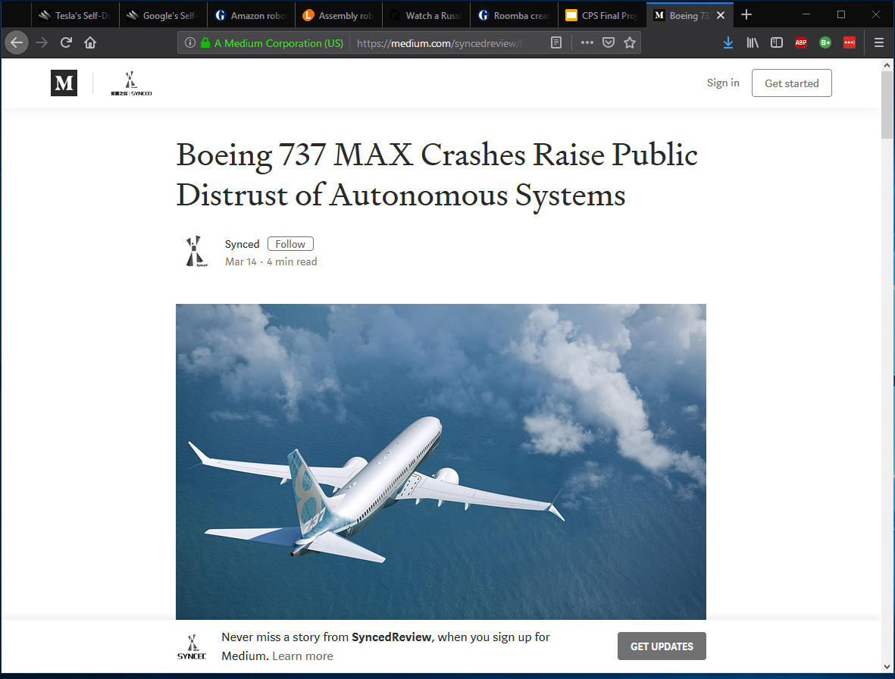
Traditional testing is not enough.

Slide 10
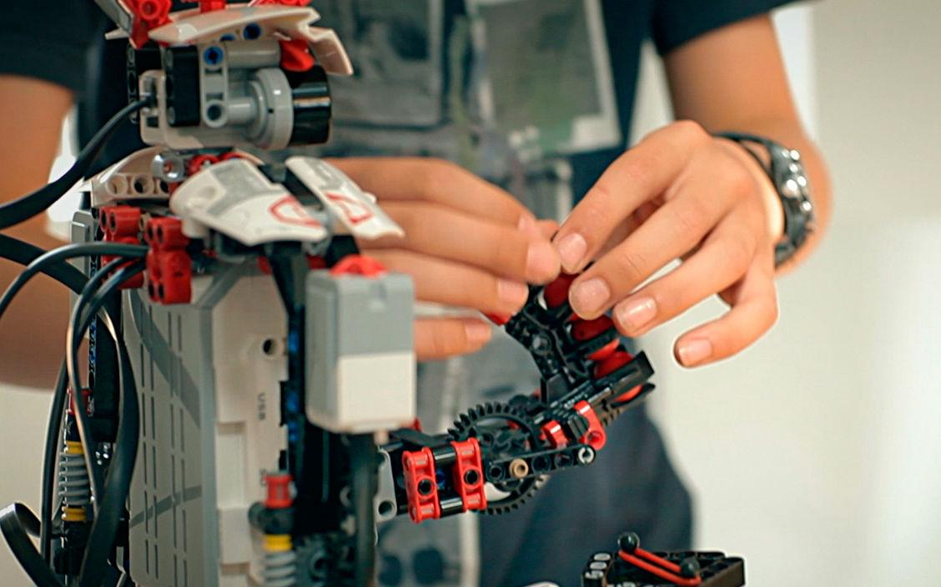
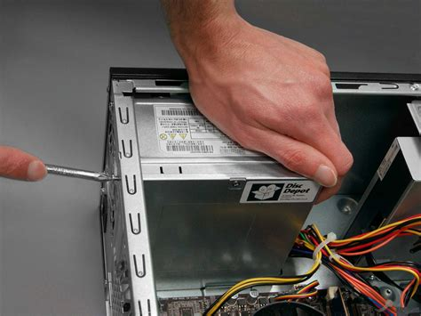
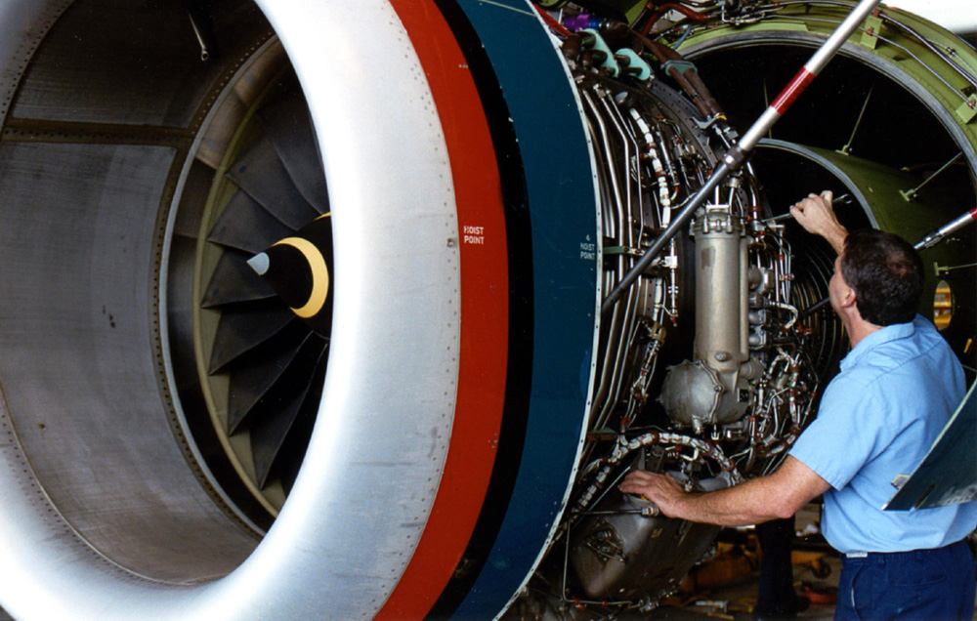
Problem
Faults occur when system changes
Errors come from incompatibilities between:
Hardware and other hardware
Hardware and software
Isolating the differences caused by hardware changes is difficult

Slide 11
Is it possible to create test cases that identify differences in robot behavior brought about by hardware changes?
Notes:
During development, deployment and maintenance of robotic applications both software and hardware is constantly changed, updated or replaced.
The effect of these changes is generally difficult to isolate or even observe.

Slide 12
Goals
Devise technique to formally model differences spurred by hardware changes.
Construct test cases that identifies and isolates differences.
(Bonus) Uncover existing bugs in legacy code.

Slide 13

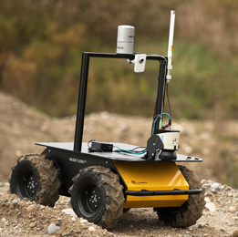
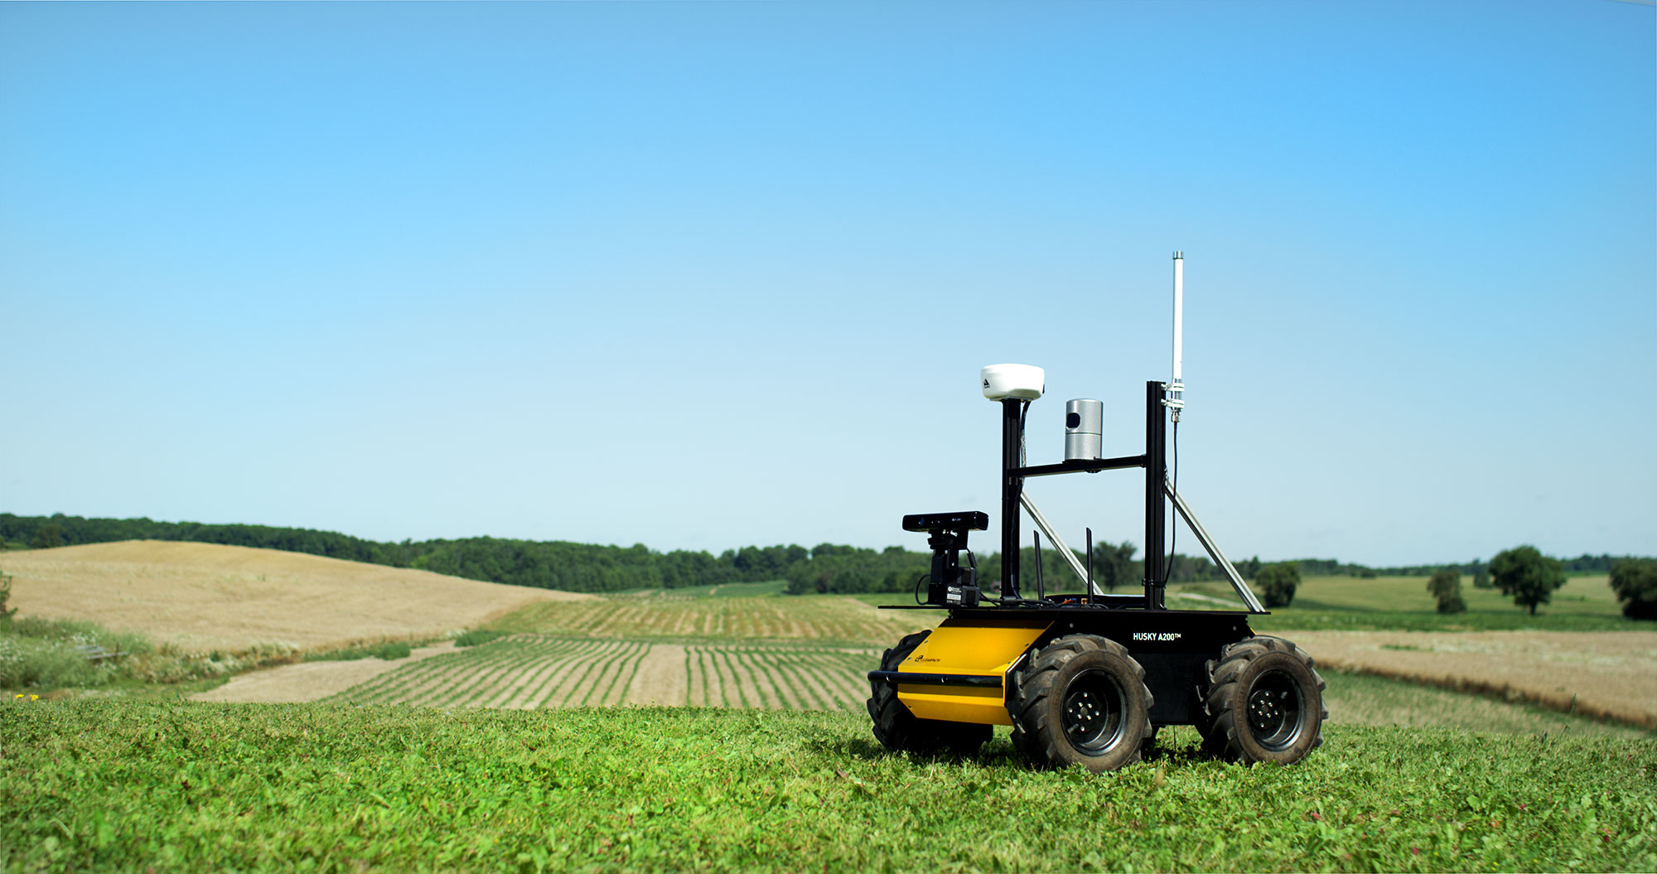
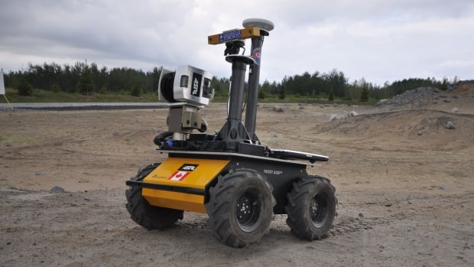
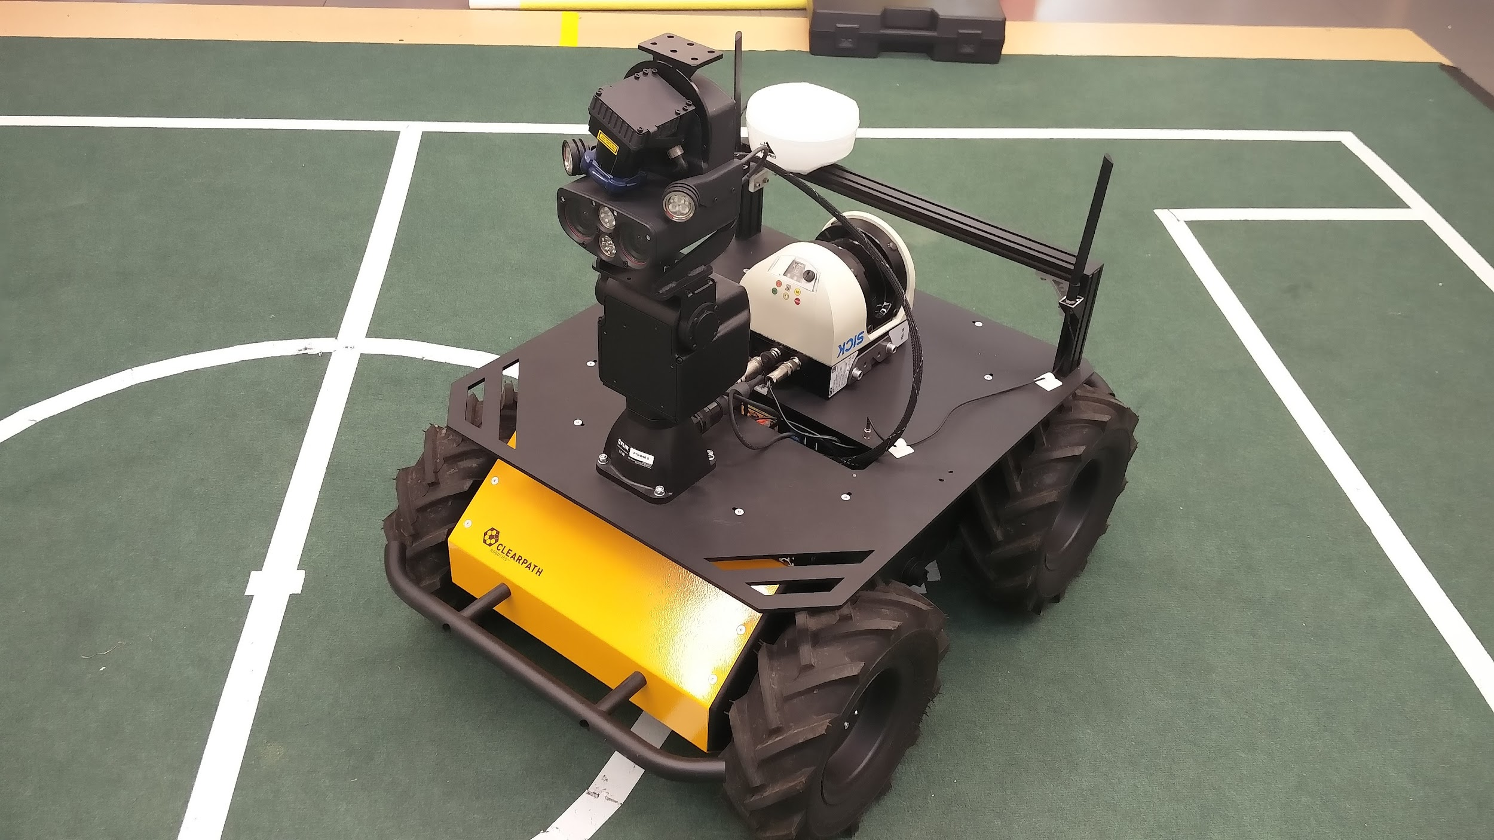
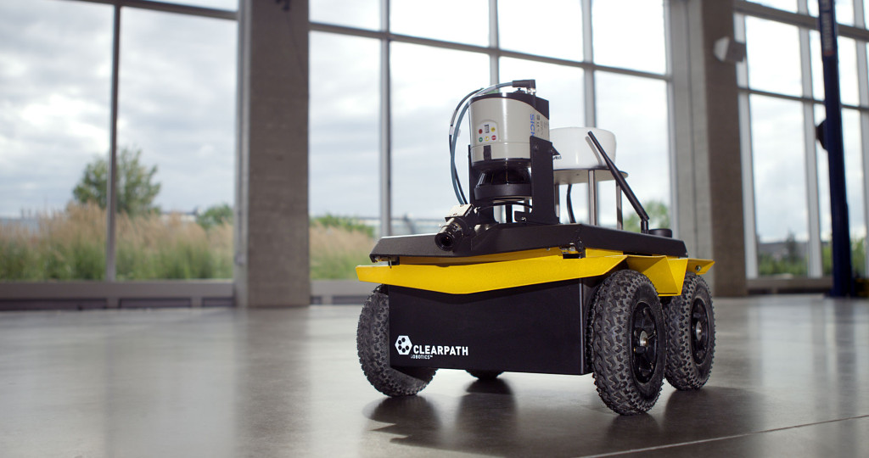
Method
Clearpath Husky Robot
Well-known autonomous ground vehicle
Very customizable
What do you notice about the Husky Robots?
Customers of Clearpath Robotics
Examples of Husky Robot

Slide 14
Method
Clearpath Husky Robot
Well-known autonomous ground vehicle
Very customizable
What do you notice about the Husky Robots?
Customers of Clearpath Robotics
Examples of Husky Robot
Notes:
Each robot is equipped with a sensor that has a set of specific attributes. Changing this sensor will change or augment the set of attributes, ultimately causing the robot to exhibit a new set of behaviors. Creating test cases which identify the differences in attributes and exhibited behaviors will allow for a visualization of the differences of each model.

Slide 15
Method
Test Generation
Constraints containing information about the both laser scanners were used to generate tests.
World Generation
The world was generated using a ground plane and cube(s). The robot was placed. A goal was set.
Work Overview
Robot Simulation
The robot was allowed to navigate autonomously to the goal. Collisions were monitored.

Slide 16
System Overview
Existing Code
Edited Existing Code
Original Work
(x,y) Position & Size
Block Placement
XML Write
World Model
Robot Model
Scanner Details
Constraints Solver
XML World Description
XML Robot Description
Contact Messages
Physic Simulation
& Robot Simulation
Scanner Readings
(x,y) Goal Position
Trajectory
Collision Checker
Robot Goal Generator
Path planning
Map
Localization of Robot

Slide 17
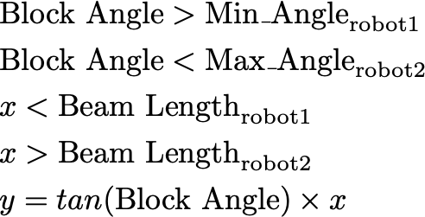
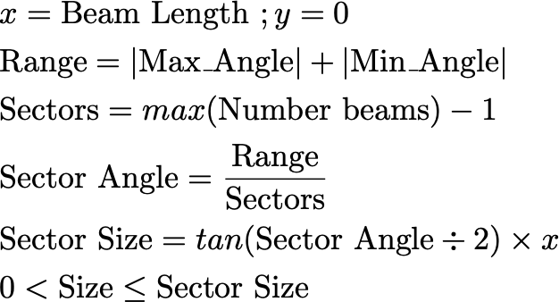
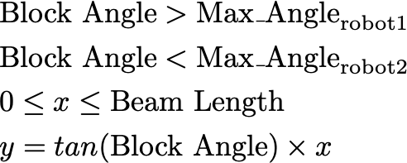
Constraints
Box
Husky Robot
Robot 1 Laser Scan
Robot 2 Laser Scan
Blind Spot Constraint
Distance Constraint
Size Constraint
Notes:
------------Don’t delete below this------------
&\textnormal{Block Angle} > \textnormal{Max}\_\textnormal{Angle}_{\textnormal{robot1}}\\
&\textnormal{Block Angle} < \textnormal{Max}\_\textnormal{Angle}_{\textnormal{robot2}}\\
&0 \leq x \leq \textnormal{Beam Length}\\
&y = tan(\textnormal{Block Angle}) \times x
&\textnormal{Block Angle} > \textnormal{Min}\_\textnormal{Angle}_{\textnormal{robot1}}\\
&\textnormal{Block Angle} < \textnormal{Max}\_\textnormal{Angle}_{\textnormal{robot2}}\\
&x < \textnormal{Beam Length}_{\textnormal{robot1}}\\
&x > \textnormal{Beam Length}_{\textnormal{robot2}}\\
&y = tan(\textnormal{Block Angle}) \times x
&x=\textnormal{Beam Length } ; y=0 \\
&\textnormal{Range} = |\textnormal{Max}\_\textnormal{Angle}| + |\textnormal{Min}\_\textnormal{Angle}|\\
&\textnormal{Sectors} = max(\textnormal{Number beams}) - 1\\
&\textnormal{Sector Angle} = \frac{\textnormal{Range}}{\textnormal{Sectors}}\\
&\textnormal{Sector Size} = tan(\textnormal{Sector Angle} \div 2) \times x\\
&0 < \textnormal{Size} \leq \textnormal{Sector Size}\\

Slide 18
Constraints
Box
Husky Robot
Robot 1 Laser Scan
Robot 2 Laser Scan
Blind Spot Constraint
Distance Constraint
Size Constraint
Notes:
------------Don’t delete below this------------
&\textnormal{Block Angle} > \textnormal{Max}\_\textnormal{Angle}_{\textnormal{robot1}}\\
&\textnormal{Block Angle} < \textnormal{Max}\_\textnormal{Angle}_{\textnormal{robot2}}\\
&0 \leq x \leq \textnormal{Beam Length}\\
&y = tan(\textnormal{Block Angle}) \times x
&\textnormal{Block Angle} > \textnormal{Min}\_\textnormal{Angle}_{\textnormal{robot1}}\\
&\textnormal{Block Angle} < \textnormal{Max}\_\textnormal{Angle}_{\textnormal{robot2}}\\
&x < \textnormal{Beam Length}_{\textnormal{robot1}}\\
&x > \textnormal{Beam Length}_{\textnormal{robot2}}\\
&y = tan(\textnormal{Block Angle}) \times x
&x=\textnormal{Beam Length } ; y=0 \\
&\textnormal{Range} = |\textnormal{Max}\_\textnormal{Angle}| + |\textnormal{Min}\_\textnormal{Angle}|\\
&\textnormal{Sectors} = max(\textnormal{Number beams}) - 1\\
&\textnormal{Sector Angle} = \frac{\textnormal{Range}}{\textnormal{Sectors}}\\
&\textnormal{Sector Size} = tan(\textnormal{Sector Angle} \div 2) \times x\\
&0 < \textnormal{Size} \leq \textnormal{Sector Size}\\

Slide 19
Constraints
Box
Husky Robot
Robot 1 Laser Scan
Robot 2 Laser Scan
Husky Robot
Blind Spot Constraint
Distance Constraint
Size Constraint
Notes:
------------Don’t delete below this------------
&\textnormal{Block Angle} > \textnormal{Max}\_\textnormal{Angle}_{\textnormal{robot1}}\\
&\textnormal{Block Angle} < \textnormal{Max}\_\textnormal{Angle}_{\textnormal{robot2}}\\
&0 \leq x \leq \textnormal{Beam Length}\\
&y = tan(\textnormal{Block Angle}) \times x
&\textnormal{Block Angle} > \textnormal{Min}\_\textnormal{Angle}_{\textnormal{robot1}}\\
&\textnormal{Block Angle} < \textnormal{Max}\_\textnormal{Angle}_{\textnormal{robot2}}\\
&x < \textnormal{Beam Length}_{\textnormal{robot1}}\\
&x > \textnormal{Beam Length}_{\textnormal{robot2}}\\
&y = tan(\textnormal{Block Angle}) \times x
&x=\textnormal{Beam Length } ; y=0 \\
&\textnormal{Range} = |\textnormal{Max}\_\textnormal{Angle}| + |\textnormal{Min}\_\textnormal{Angle}|\\
&\textnormal{Sectors} = max(\textnormal{Number beams}) - 1\\
&\textnormal{Sector Angle} = \frac{\textnormal{Range}}{\textnormal{Sectors}}\\
&\textnormal{Sector Size} = tan(\textnormal{Sector Angle} \div 2) \times x\\
&0 < \textnormal{Size} \leq \textnormal{Sector Size}\\

Slide 20
Constraints
Box
Husky Robot
Robot 1 Laser Scan
Robot 2 Laser Scan
Blind Spot Constraint
Distance Constraint
Size Constraint
Notes:
------------Don’t delete below this------------
&\textnormal{Block Angle} > \textnormal{Max}\_\textnormal{Angle}_{\textnormal{robot1}}\\
&\textnormal{Block Angle} < \textnormal{Max}\_\textnormal{Angle}_{\textnormal{robot2}}\\
&0 \leq x \leq \textnormal{Beam Length}\\
&y = tan(\textnormal{Block Angle}) \times x
&\textnormal{Block Angle} > \textnormal{Min}\_\textnormal{Angle}_{\textnormal{robot1}}\\
&\textnormal{Block Angle} < \textnormal{Max}\_\textnormal{Angle}_{\textnormal{robot2}}\\
&x < \textnormal{Beam Length}_{\textnormal{robot1}}\\
&x > \textnormal{Beam Length}_{\textnormal{robot2}}\\
&y = tan(\textnormal{Block Angle}) \times x
&x=\textnormal{Beam Length } ; y=0 \\
&\textnormal{Range} = |\textnormal{Max}\_\textnormal{Angle}| + |\textnormal{Min}\_\textnormal{Angle}|\\
&\textnormal{Sectors} = max(\textnormal{Number beams}) - 1\\
&\textnormal{Sector Angle} = \frac{\textnormal{Range}}{\textnormal{Sectors}}\\
&\textnormal{Sector Size} = tan(\textnormal{Sector Angle} \div 2) \times x\\
&0 < \textnormal{Size} \leq \textnormal{Sector Size}\\

Slide 21
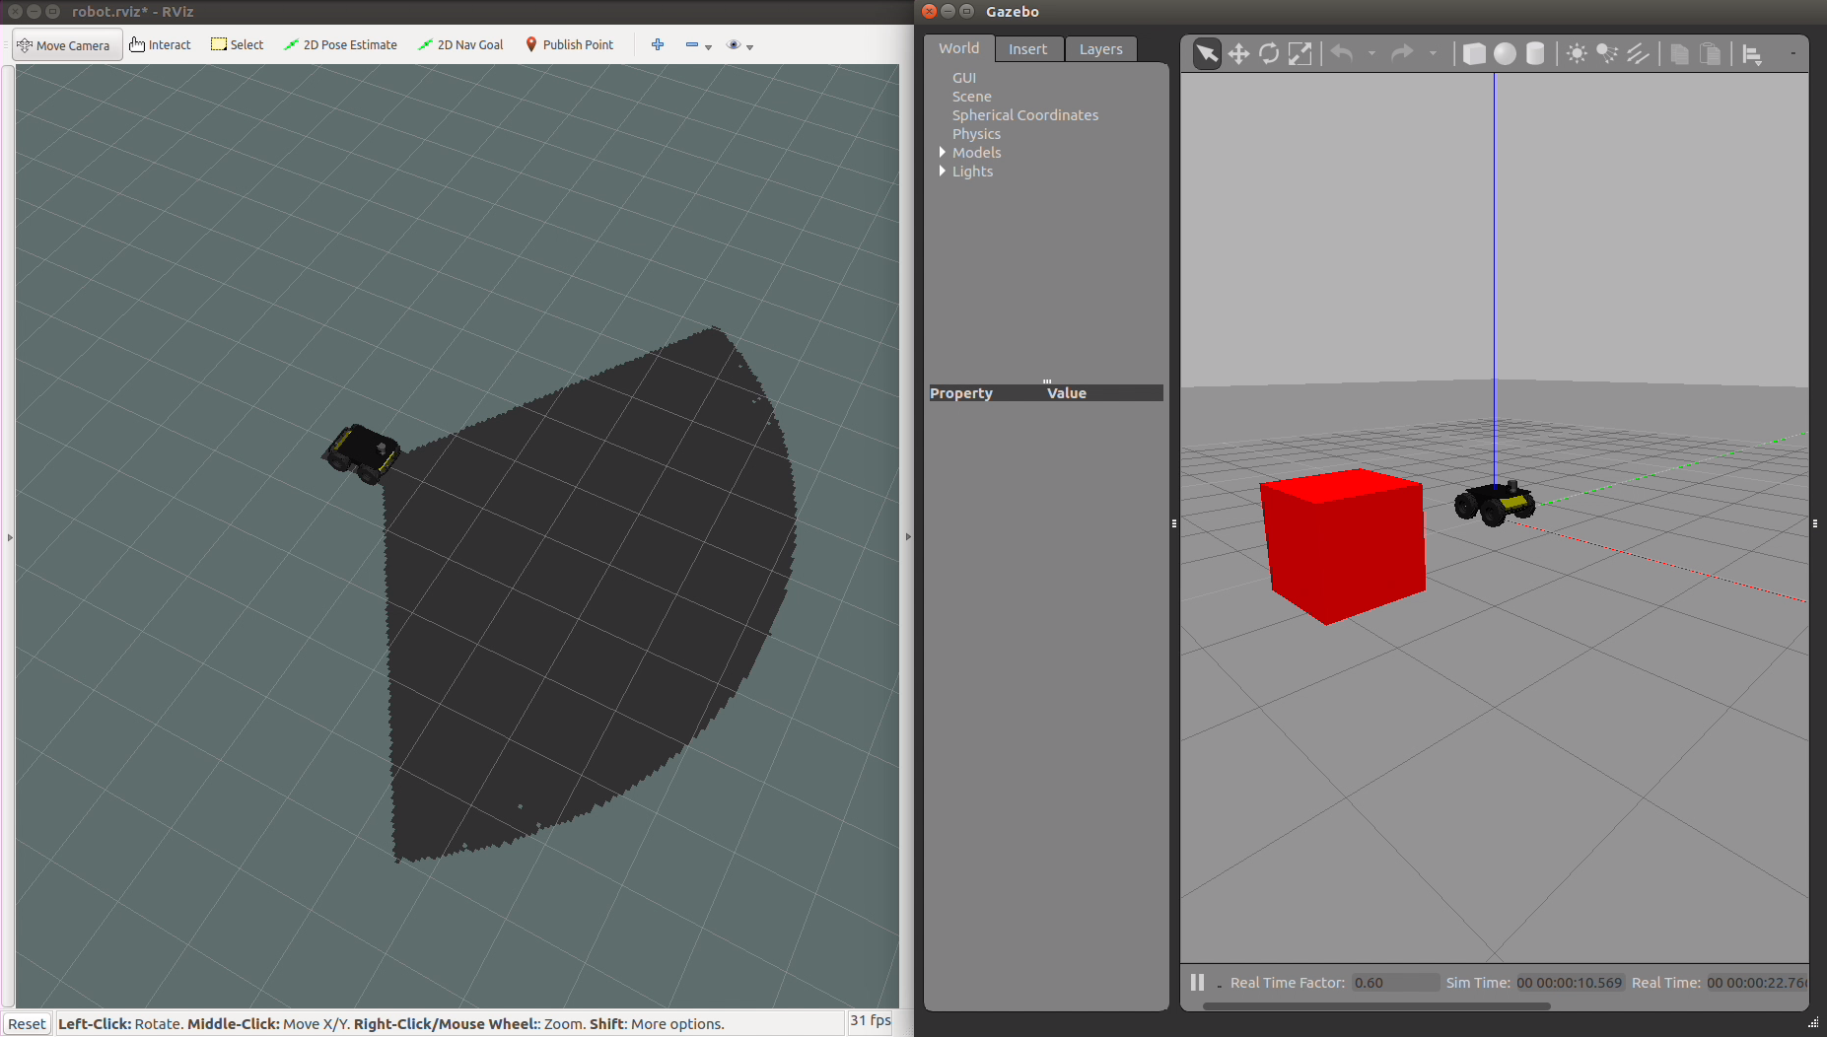
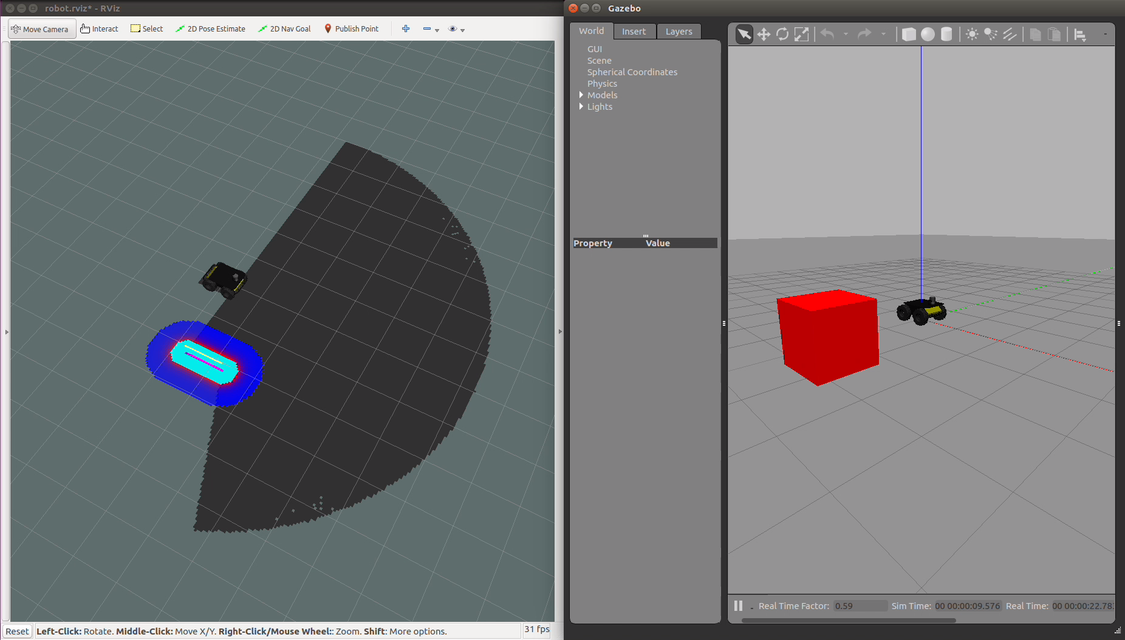
Results - Blind Constraint
Robot 1:
Minimum Angle: -1 rad
Maximum Angle: 1 rad
Robot 2:
Minimum Angle: -𝜋/2 rad
Maximum Angle: 𝜋/2 rad
Notes:
https://www.dropbox.com/s/pqmiwd14dsyacfi/RawTests.mp4?dl=0

Slide 22
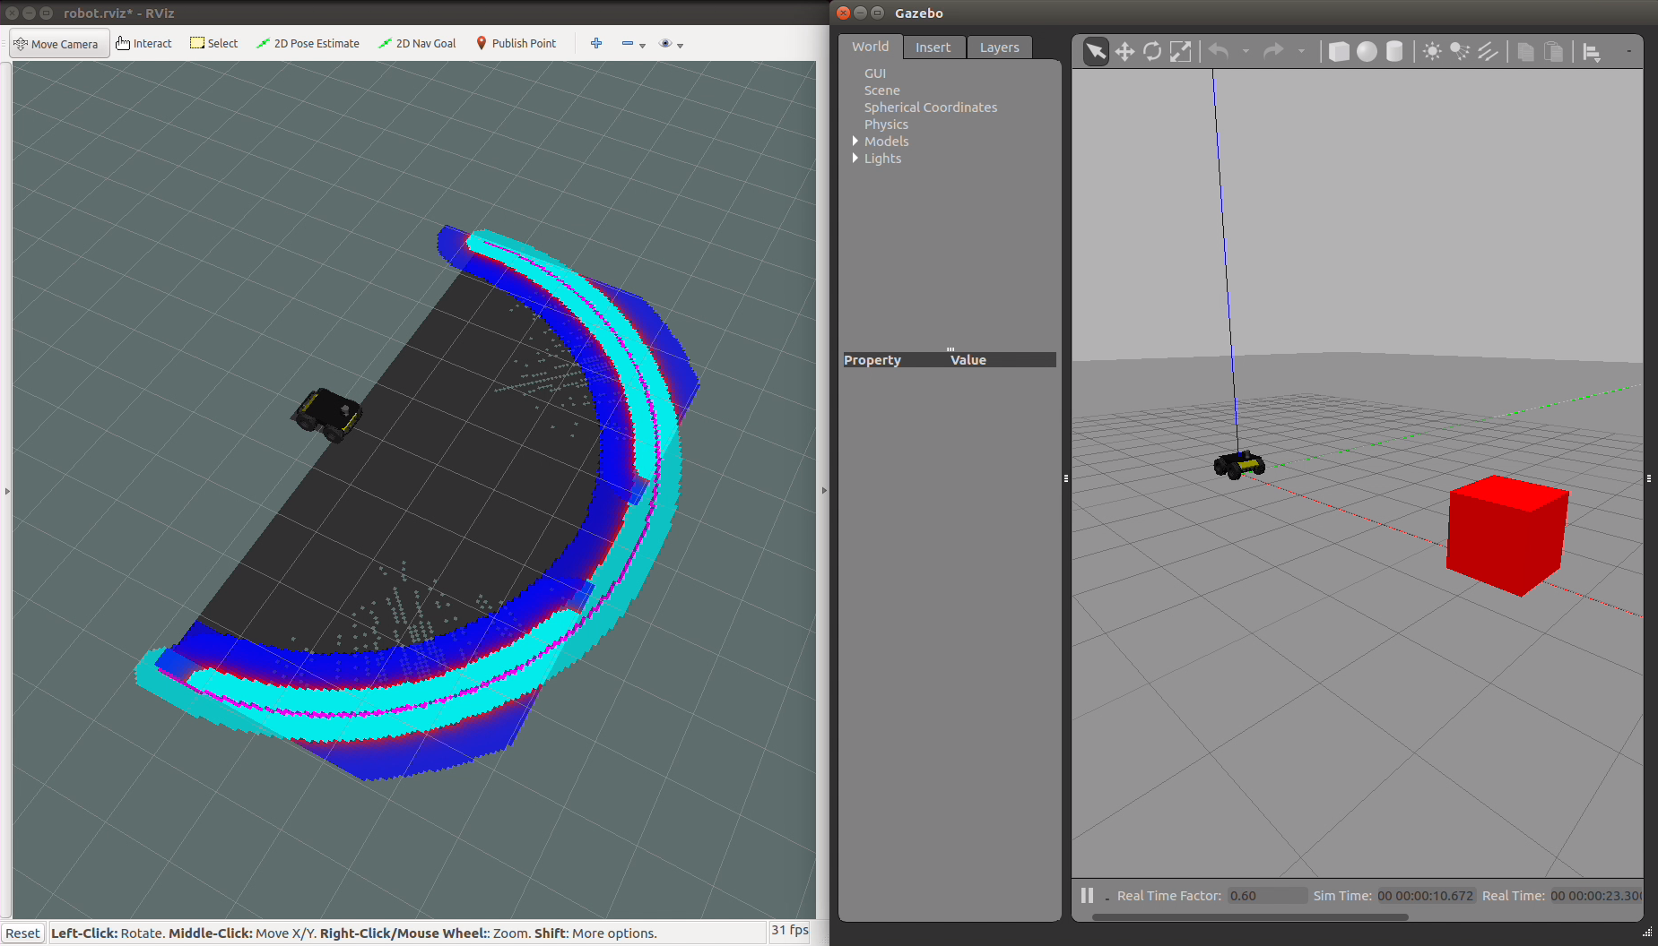
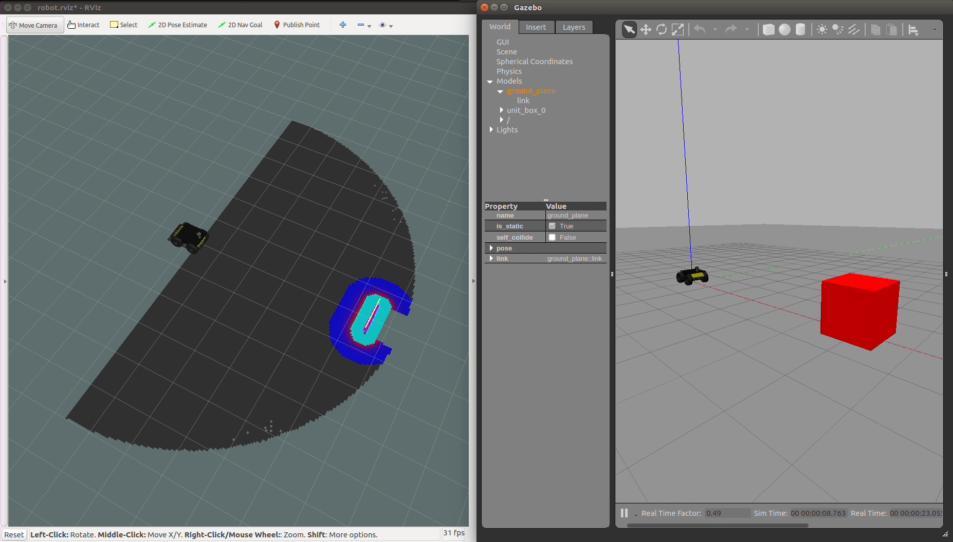
Results - Distance Constraint
Robot 1:
Max Range: 5m
Robot 2:
Max Range: 10m
Notes:
https://www.dropbox.com/s/pqmiwd14dsyacfi/RawTests.mp4?dl=0

Slide 23
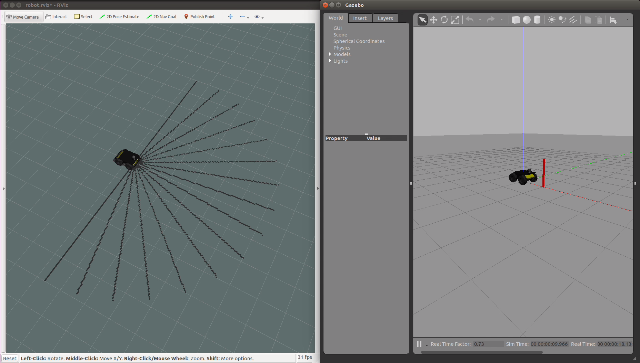
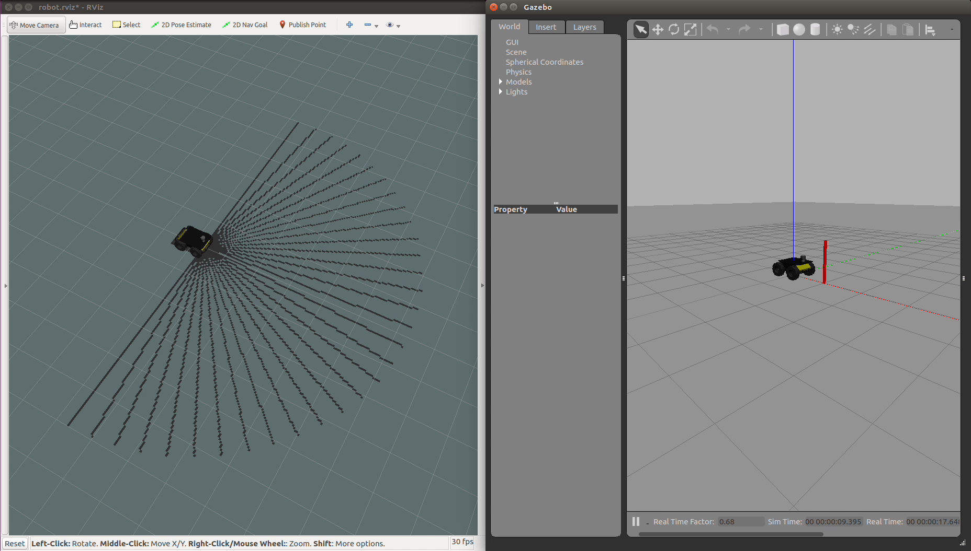
Results - Size Constraint
Robot 1:
Resolution: 16 samples
Robot 2:
Resolution: 32 samples
Notes:
https://www.dropbox.com/s/pqmiwd14dsyacfi/RawTests.mp4?dl=0

Slide 24

Questions

